Slide 1

Embedded Systems
Anupam Sobti

Slide 2
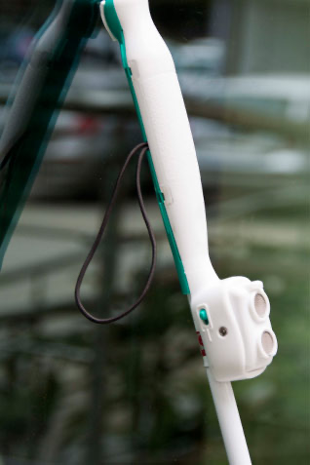
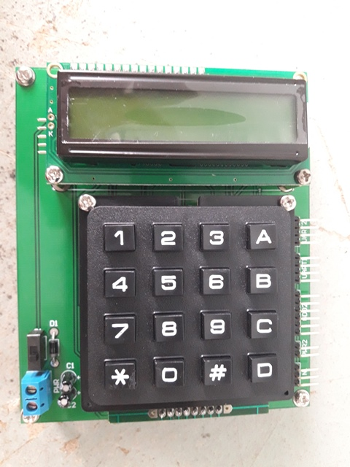
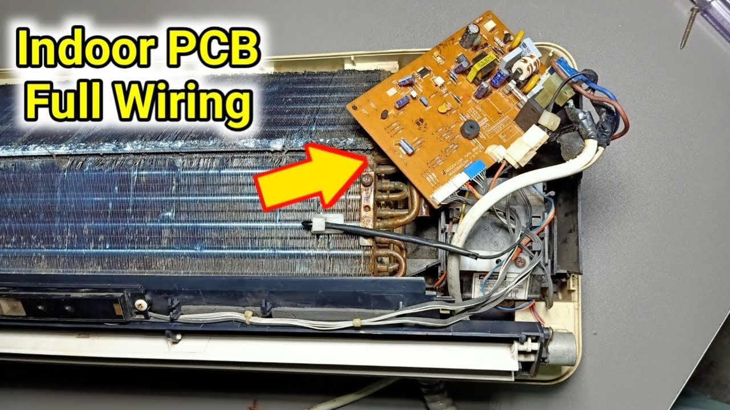
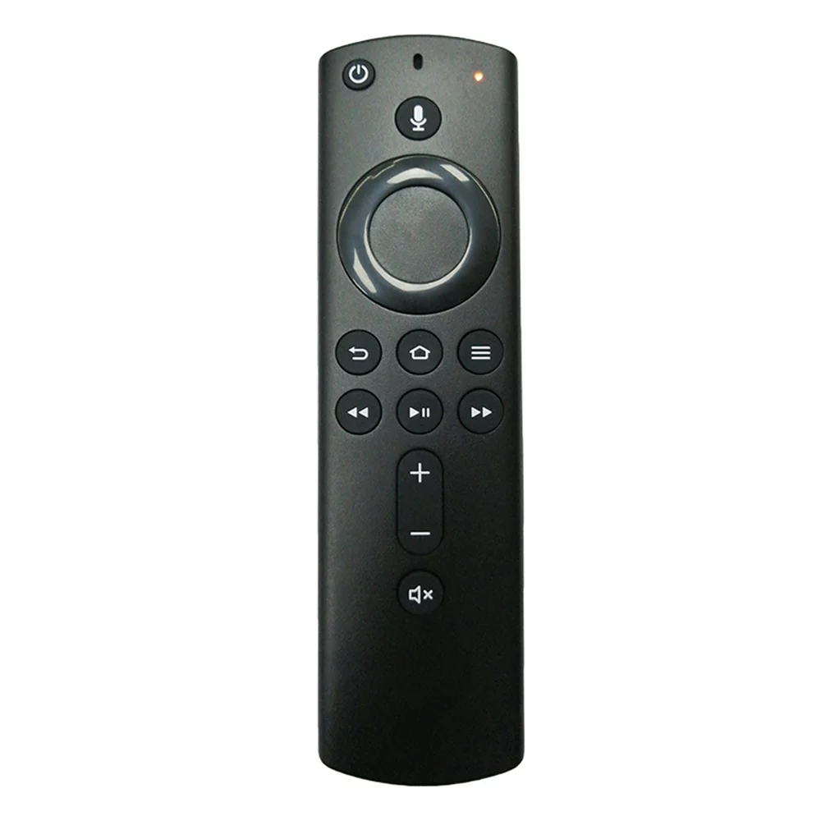
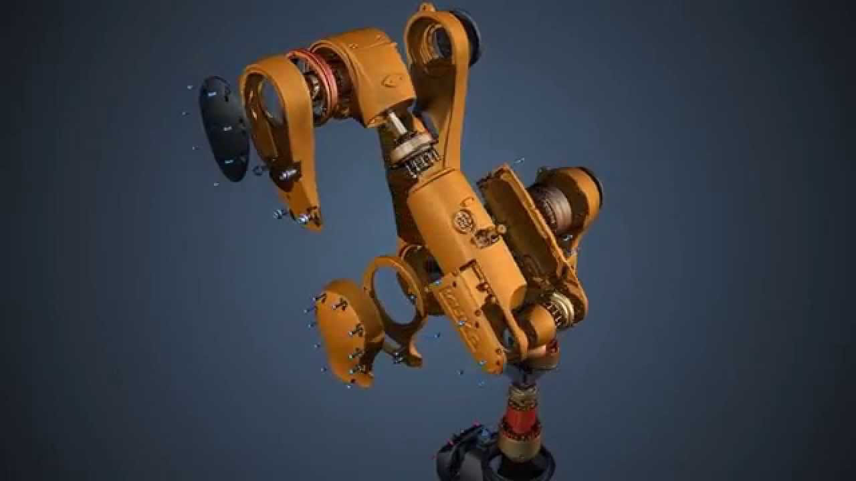
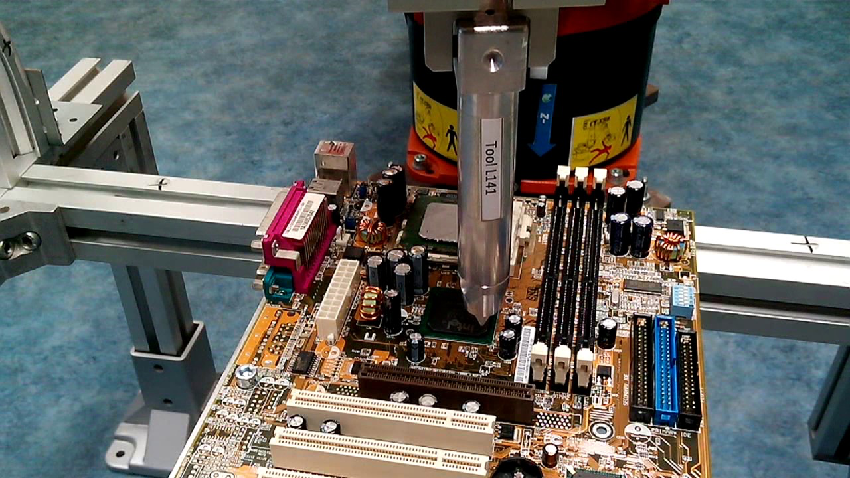
What?
An electronic system with a dedicated purpose
Air Conditioner PCB Tutorial With Its Working and Repair - Hackster.io

Slide 3
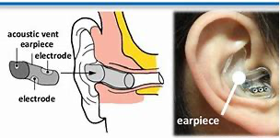
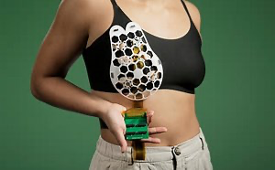
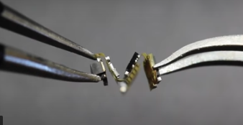
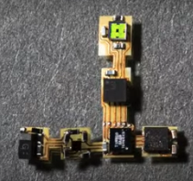
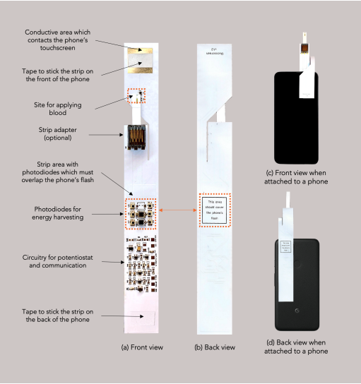
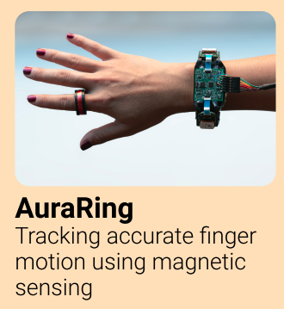
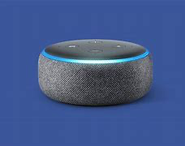
What?
In-ear EEG
A wearable ultrasound scanner could detect breast cancer earlier
Battery Free sensors that float in the wind
Glucoscreen
Amazon Alexa

Slide 4
Why?
Interface between humans and environment
There is no software without hardware and hardware is a rare skill even today
All grand challenges require some hardware:
Sustainable practices
Optimal resource usage – energy, water, heat, etc.
Health
Food
Augment human intelligence through additional sensing/perception capabilities

Slide 5
Why should YOU do it?
Build next-gen hardware – drones, robots, but also remotes, fans, air conditioners, cooking stoves, generators!
Build a physical reality for software solutions and vice versa
Sheer lack of stable hardware – broken traffic lights, unrepairable devices, expensive imports!
Upcoming medtech, smart cities!
Jobs: firmware engineer (e.g., Intel, Oculus, Google, Apple), hardware design (medtech, car companies, renewable energy devices, Bosch), etc.
Menti

Slide 6
Why should you NOT do it?
Chill course hai
Aur kya karein?
Exam nahi hai
... because you will pull your hair out 😄

Slide 7
How?
Basic electronics – understand power requirements – steady state and transient
Understand Computer Architecture – Every architecture is different offering various specialist use cases
Software – Various programming models are used – embedded C, OS, RTOS, Rust!

Slide 8

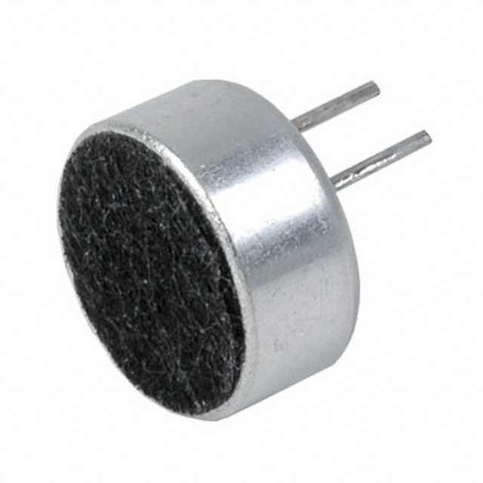
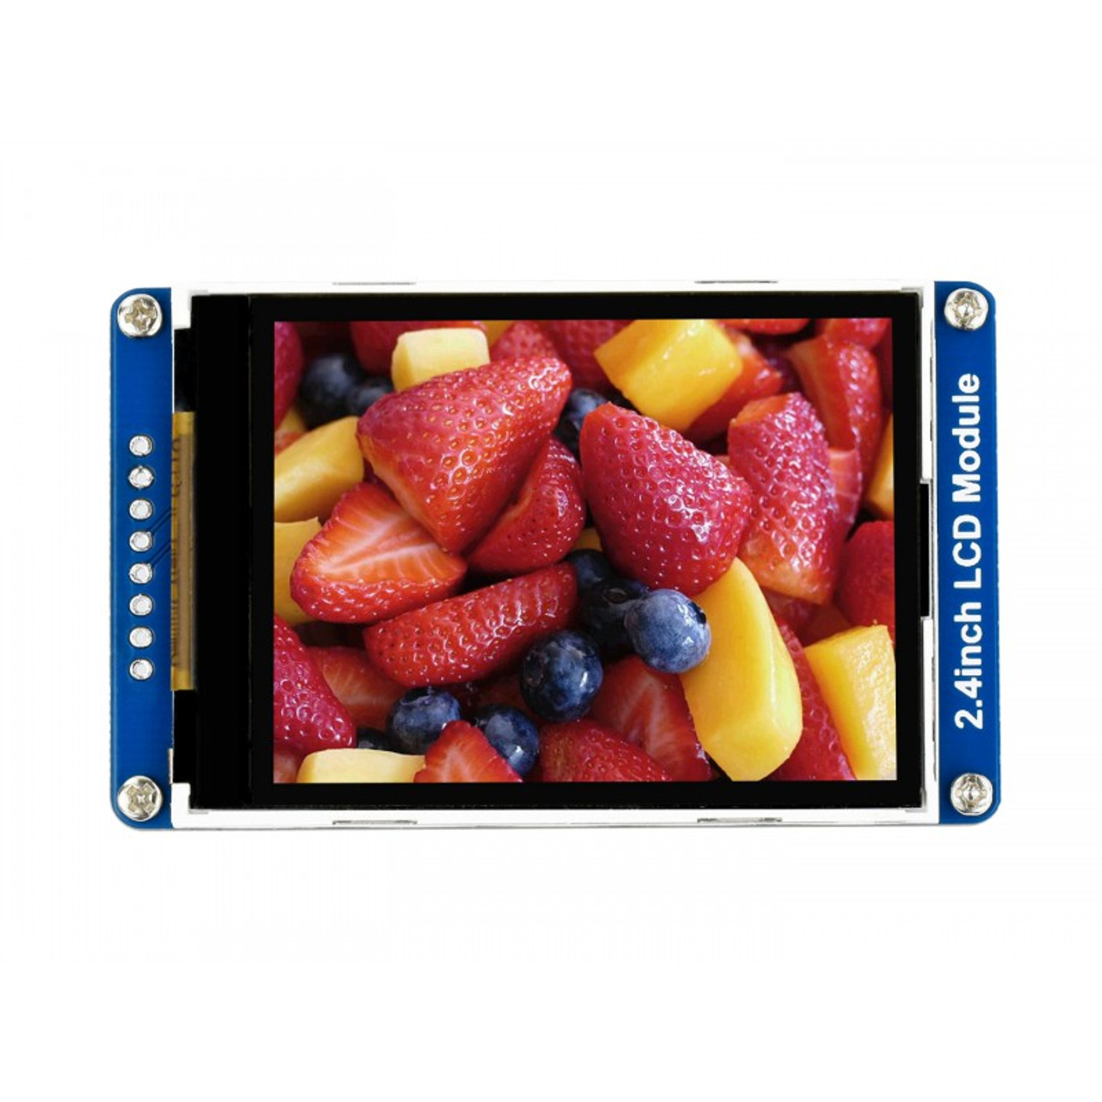
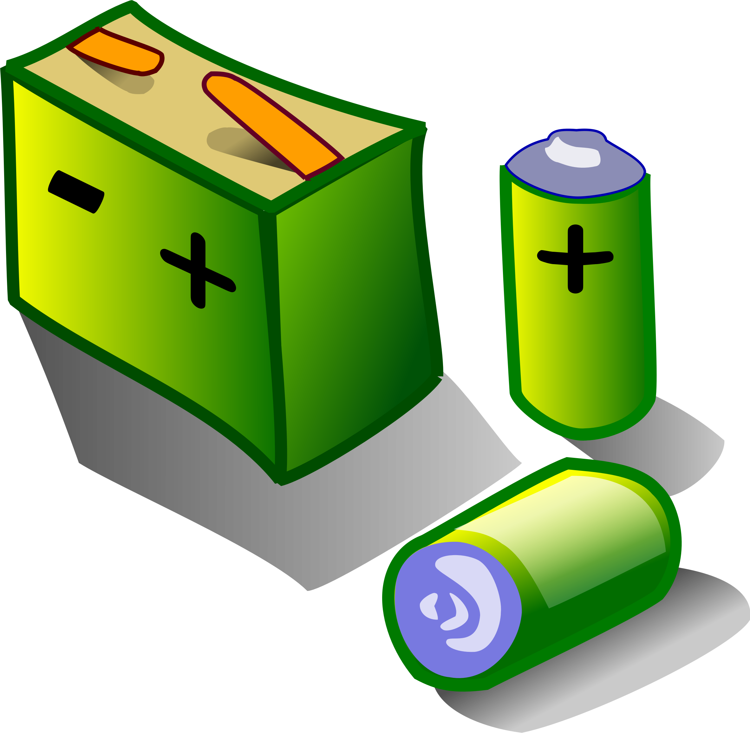
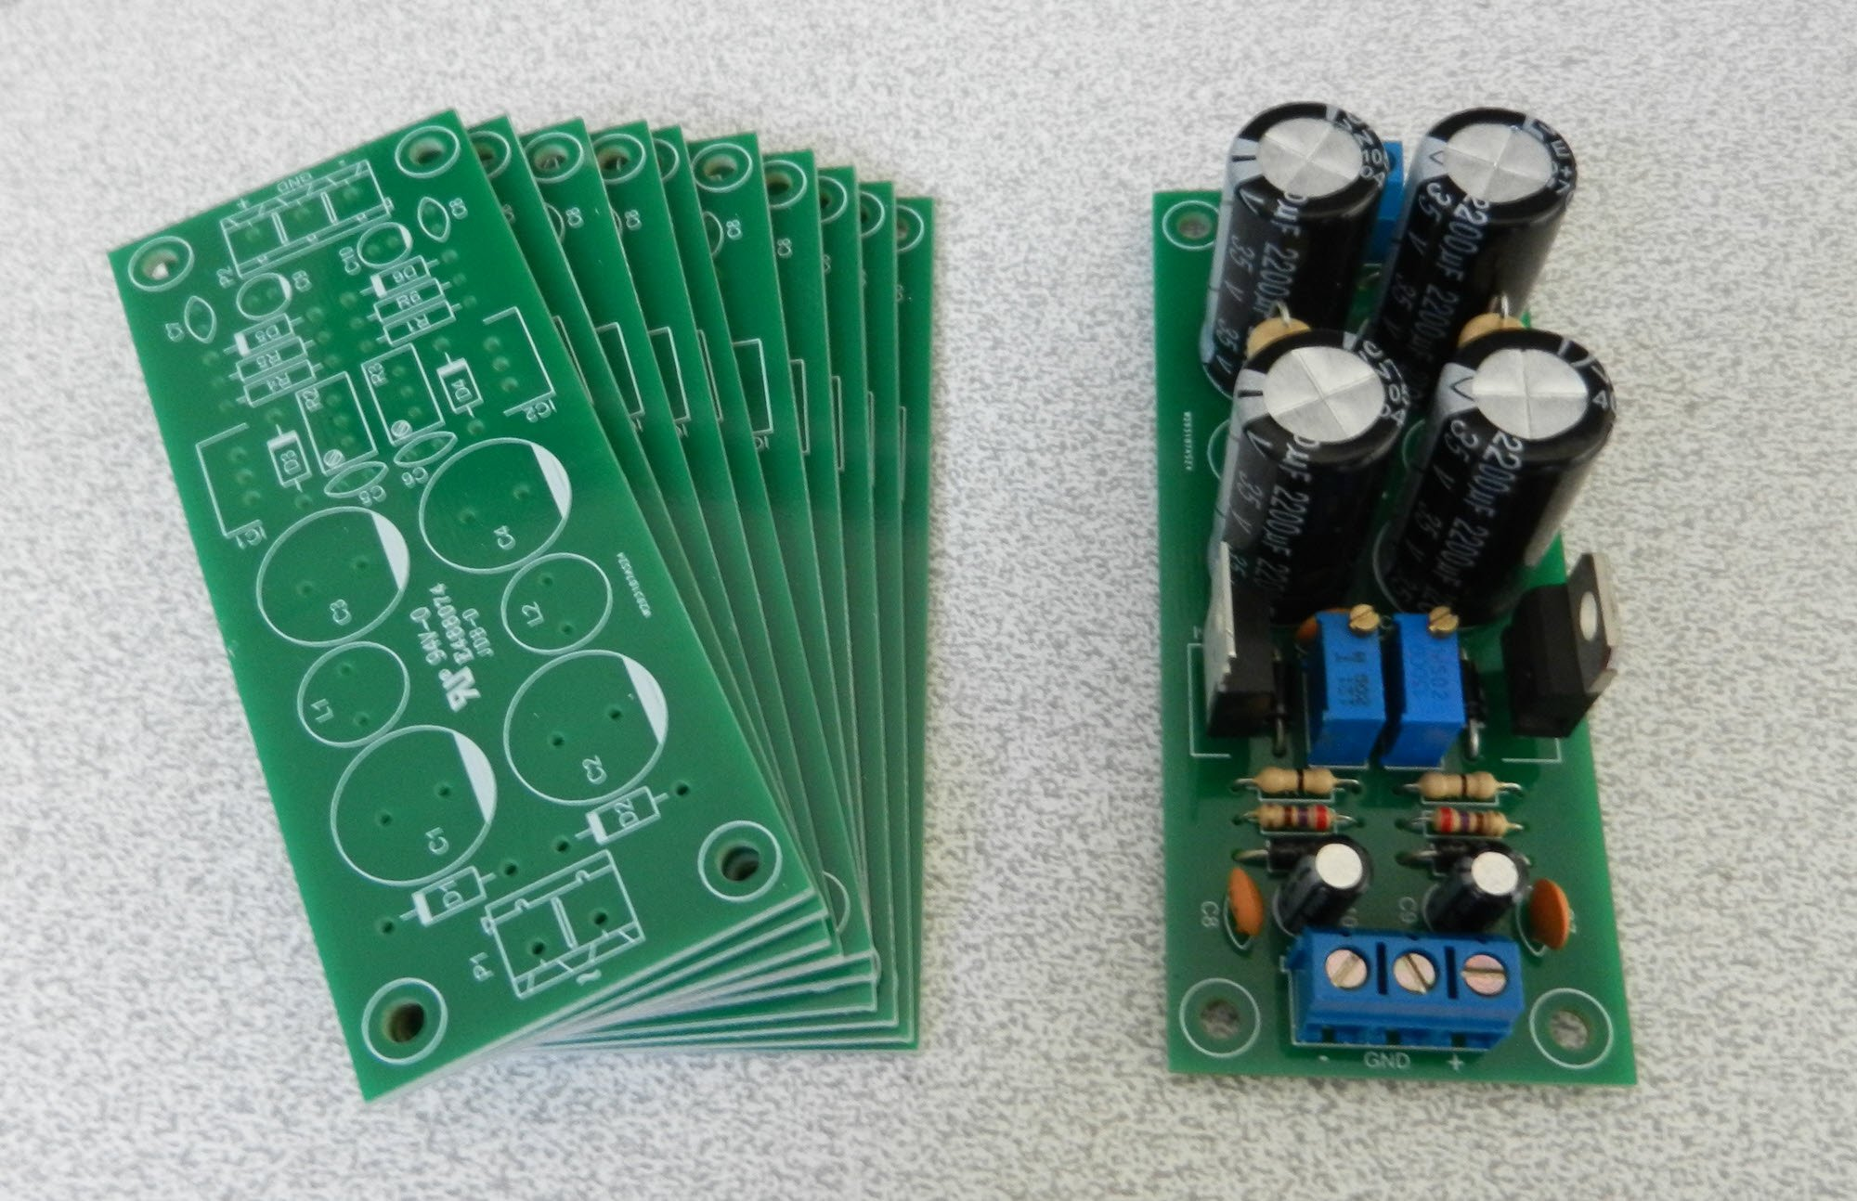
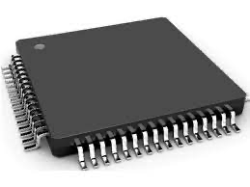

The building blocks
Peripherals
Power delivery network
Peripheral Interfaces
Processor
RAM
Reliable power source
Persistent Memory
Communication
Compute

Slide 9
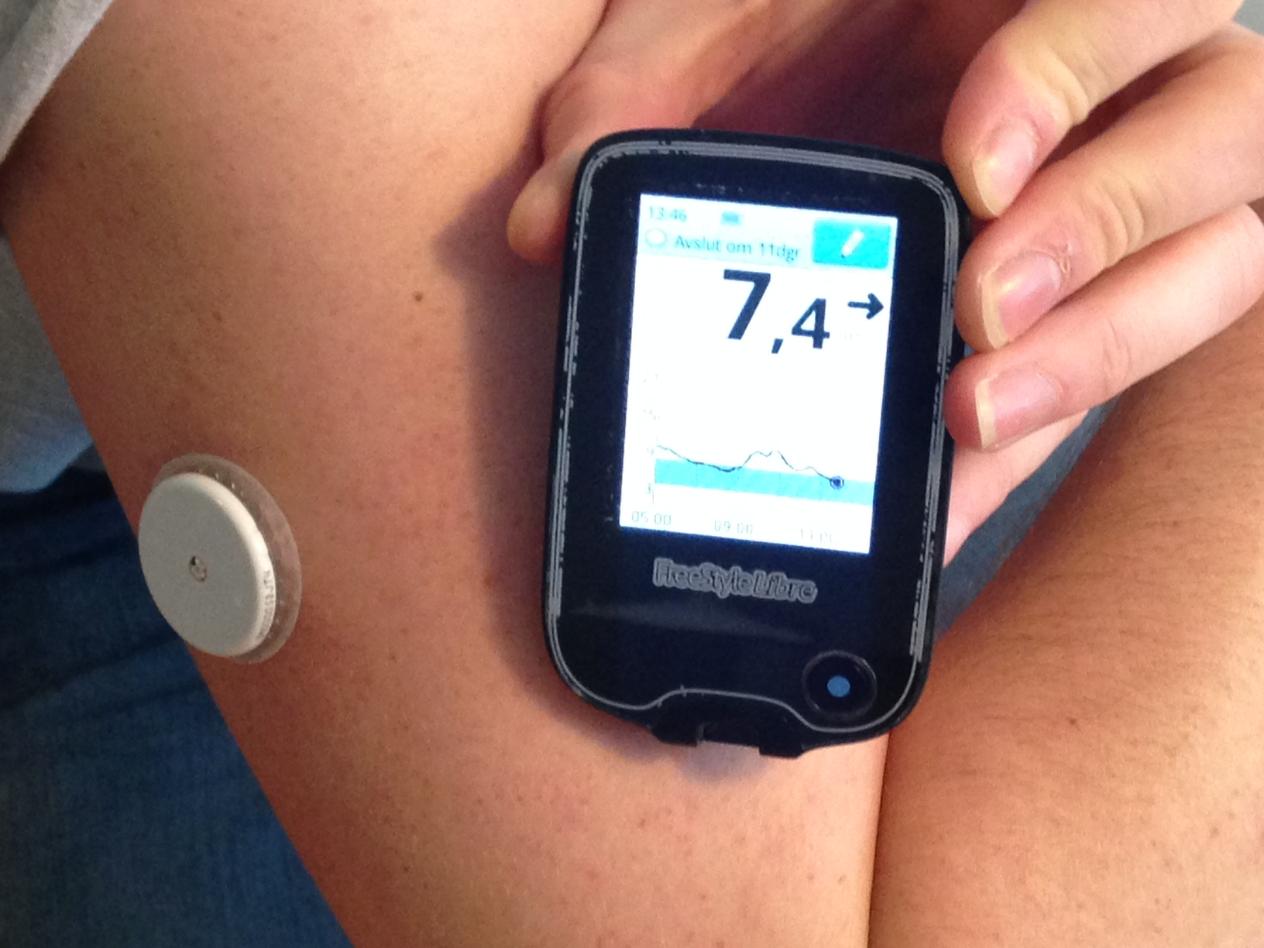
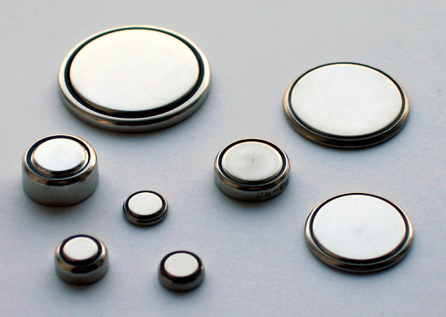
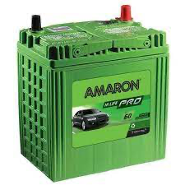
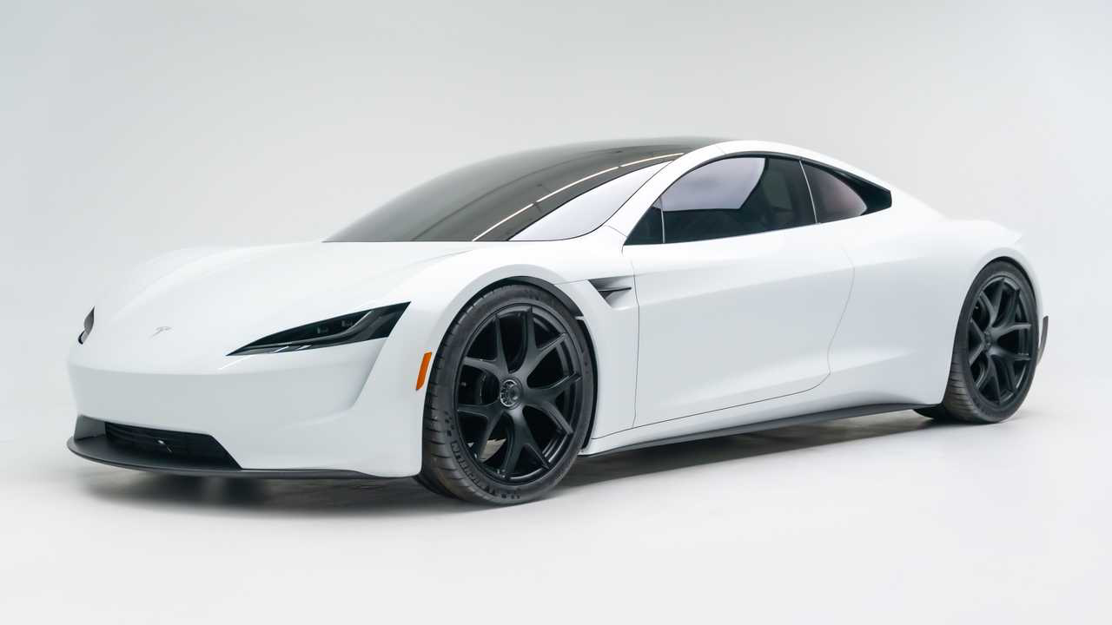
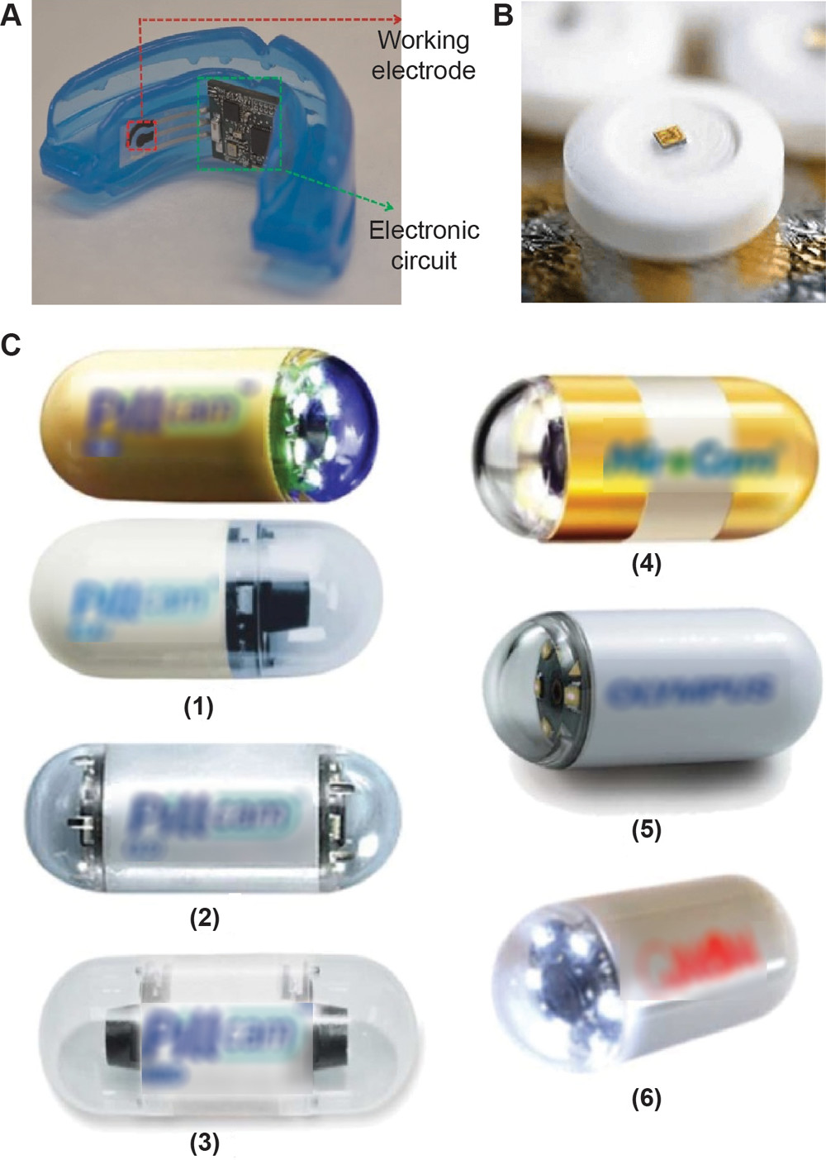
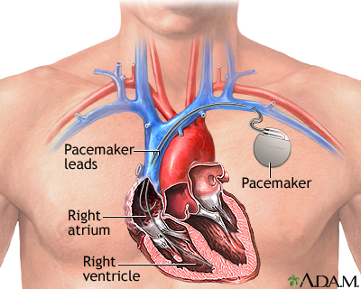
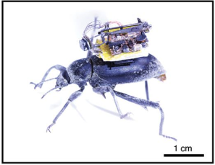
Constraints
Battery Life
Form Factor
Cost of failure
Performance requirement

Slide 10
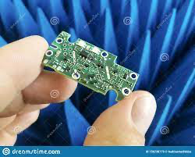
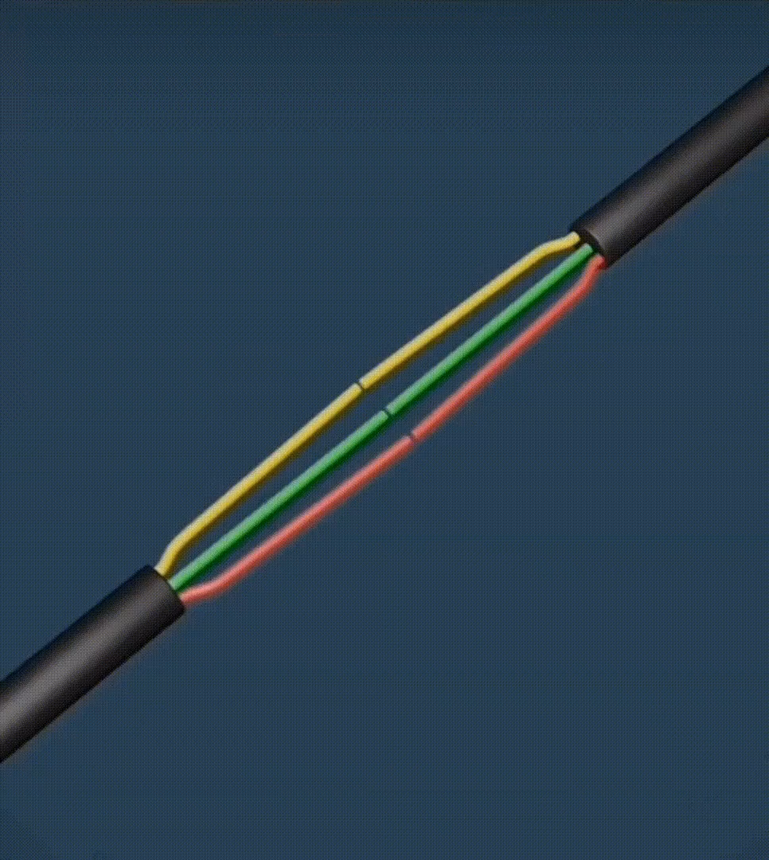
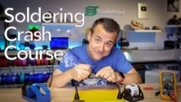
Some basics
Hand-holding circuits
Putting wires together

Slide 11
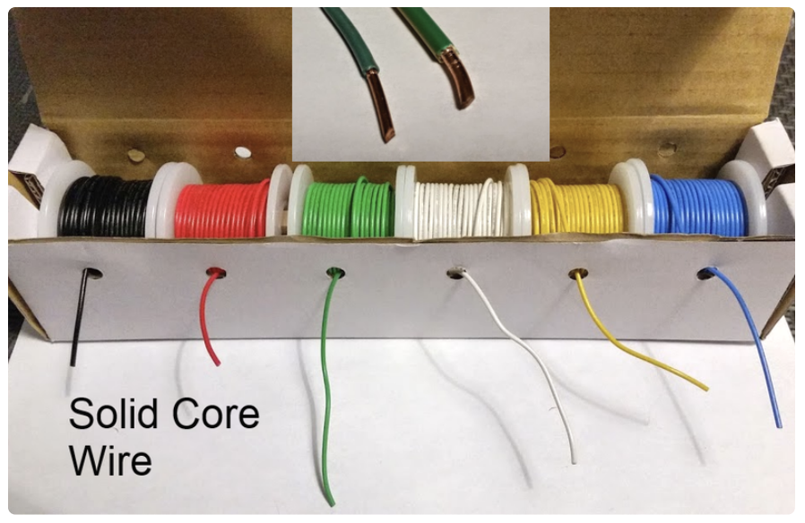
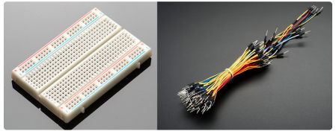
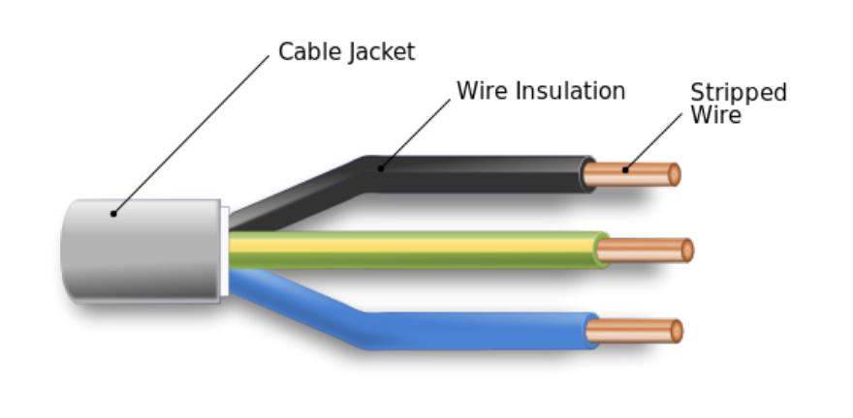
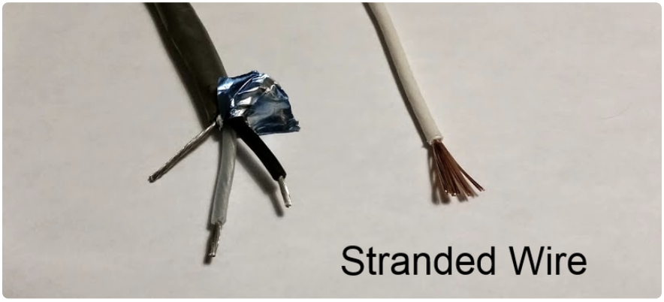
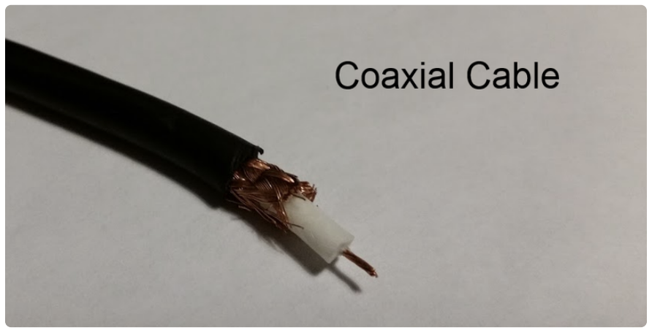
Wires
wires-and-connections.pdf (adafruit.com)
Cables
Breadboard | Single core solid wire
HF Signals | Coaxial cables
More current? | Stranded Wires
Wearables | Conductive Threads
Flexible electronics | Copper Tape
Secure your cables | Ties, clips, bolts
HF signals

Slide 12
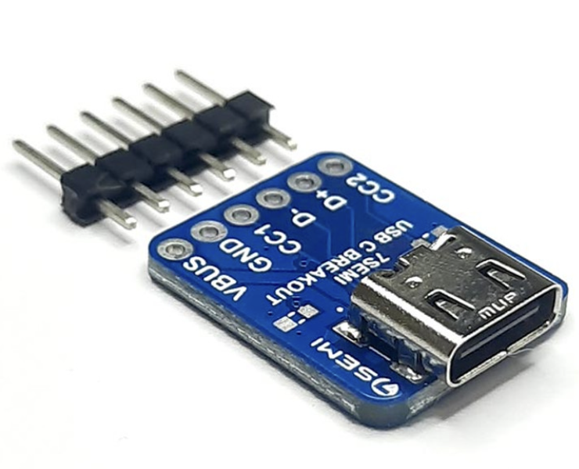
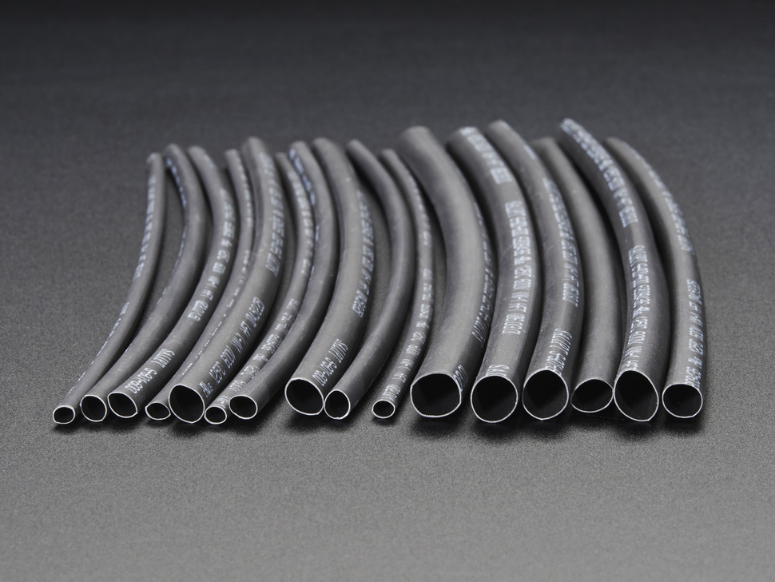
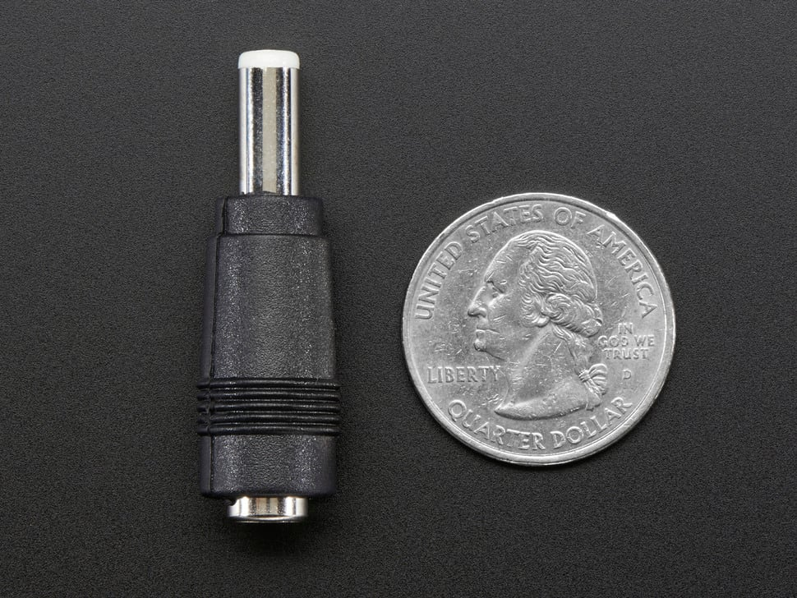
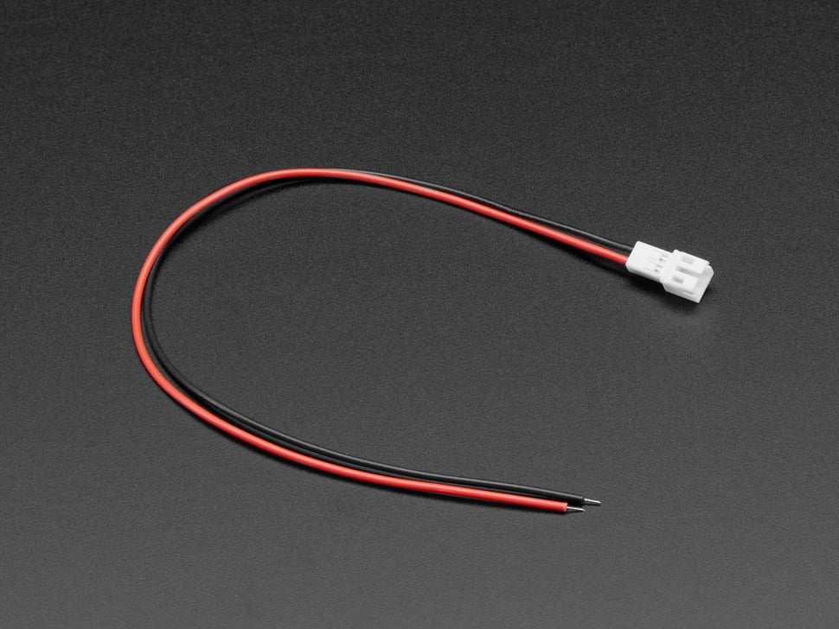
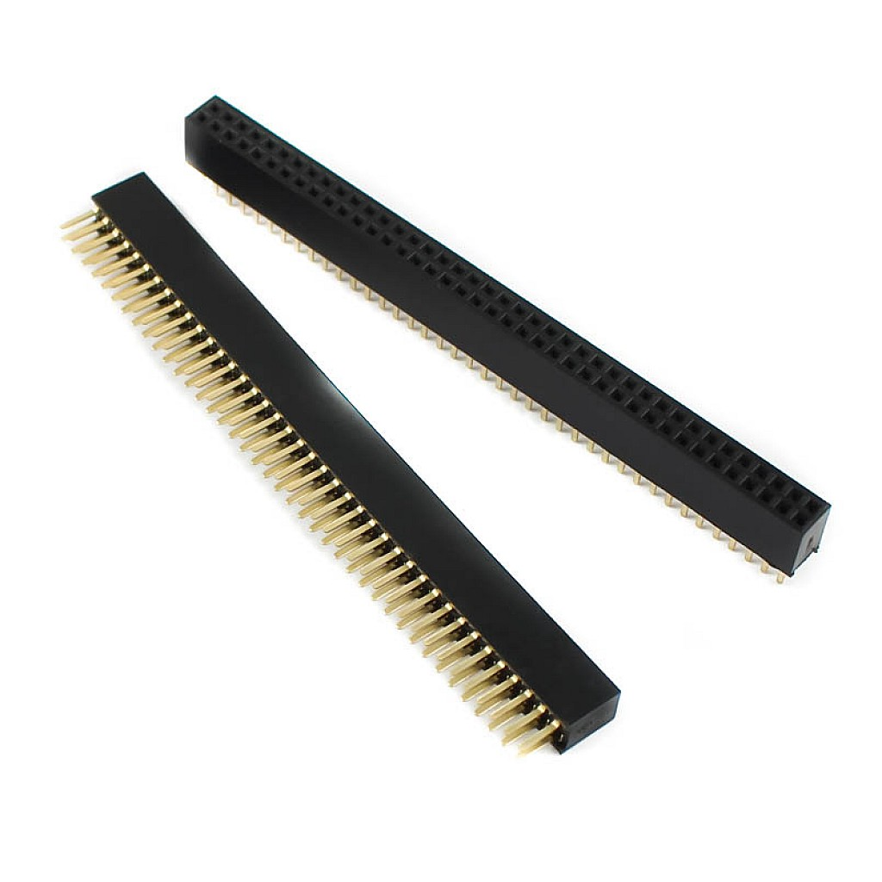
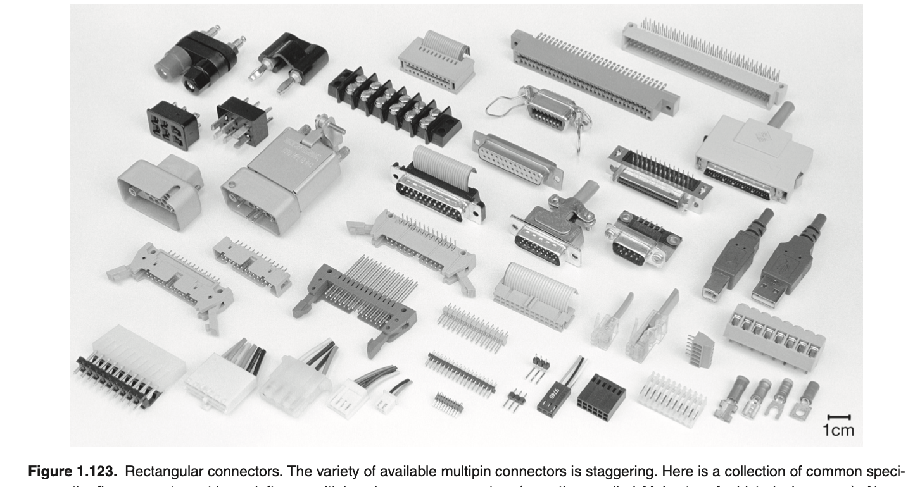
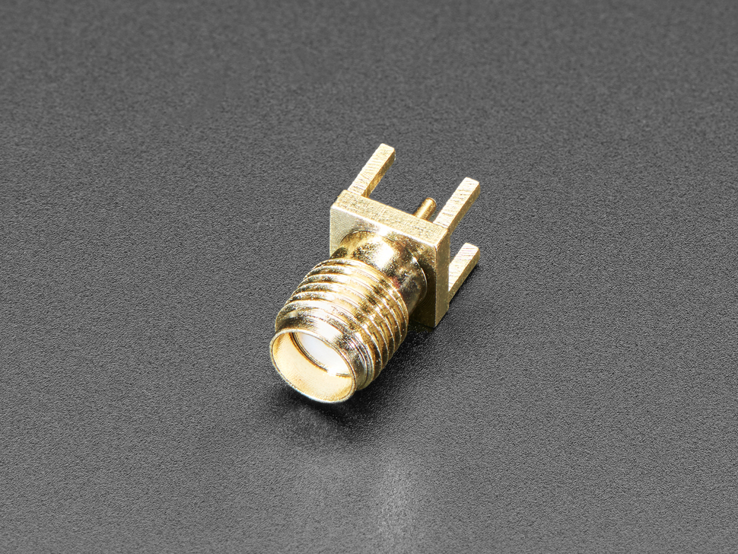
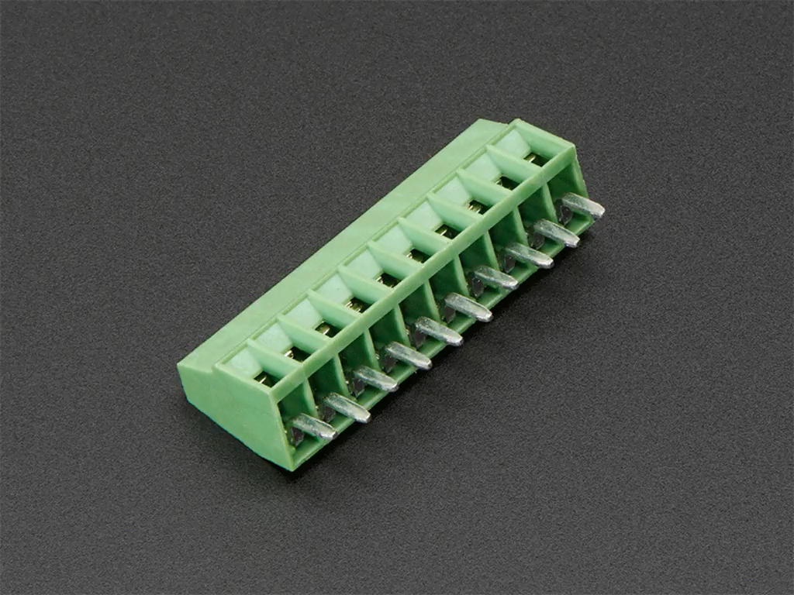
Connectors
wires-and-connections.pdf (adafruit.com)
Power
Barrel Plugs
JST Connectors Japan Solderless Terminals
USB Connectors
Shrinks

Slide 13
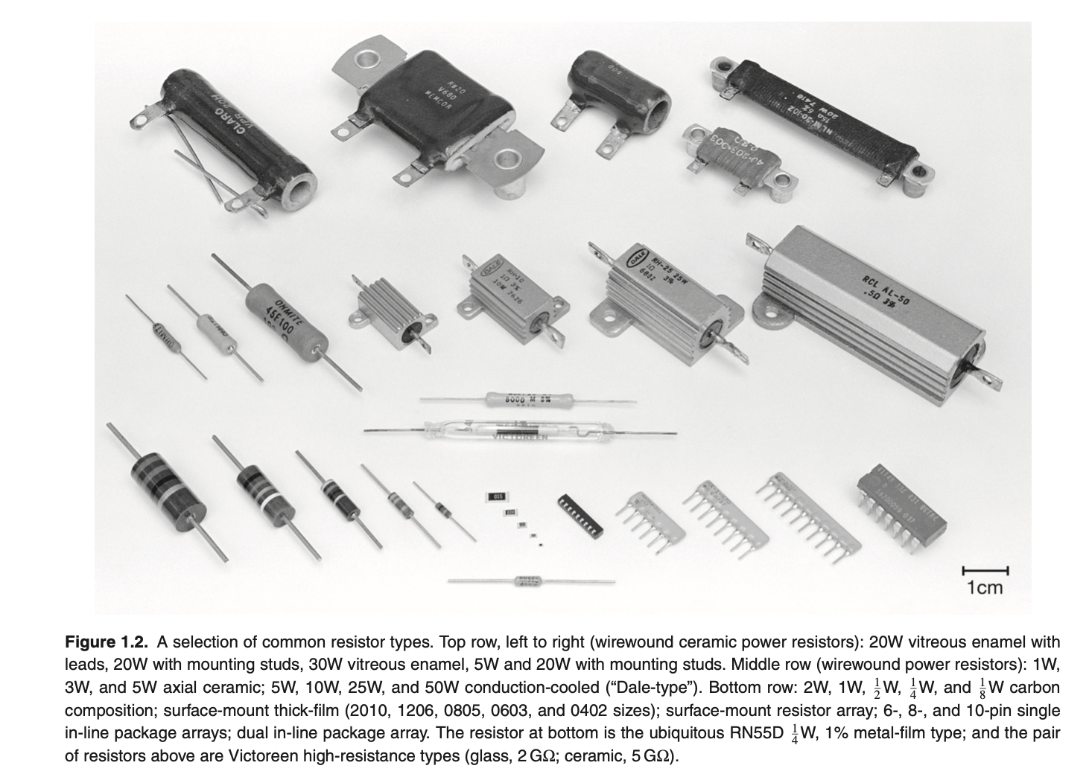
Resistors
From Art of Electronics, 3rd Ed

Slide 14
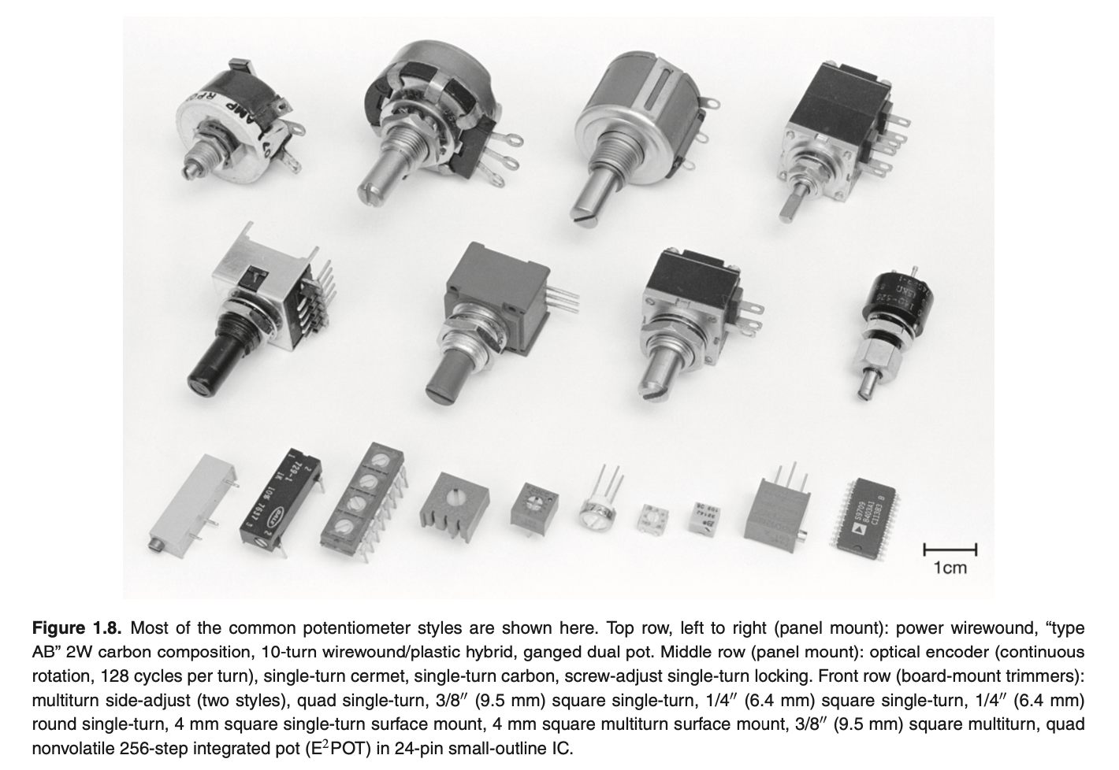
Variable Resistors
From Art of Electronics, 3rd Ed

Slide 15
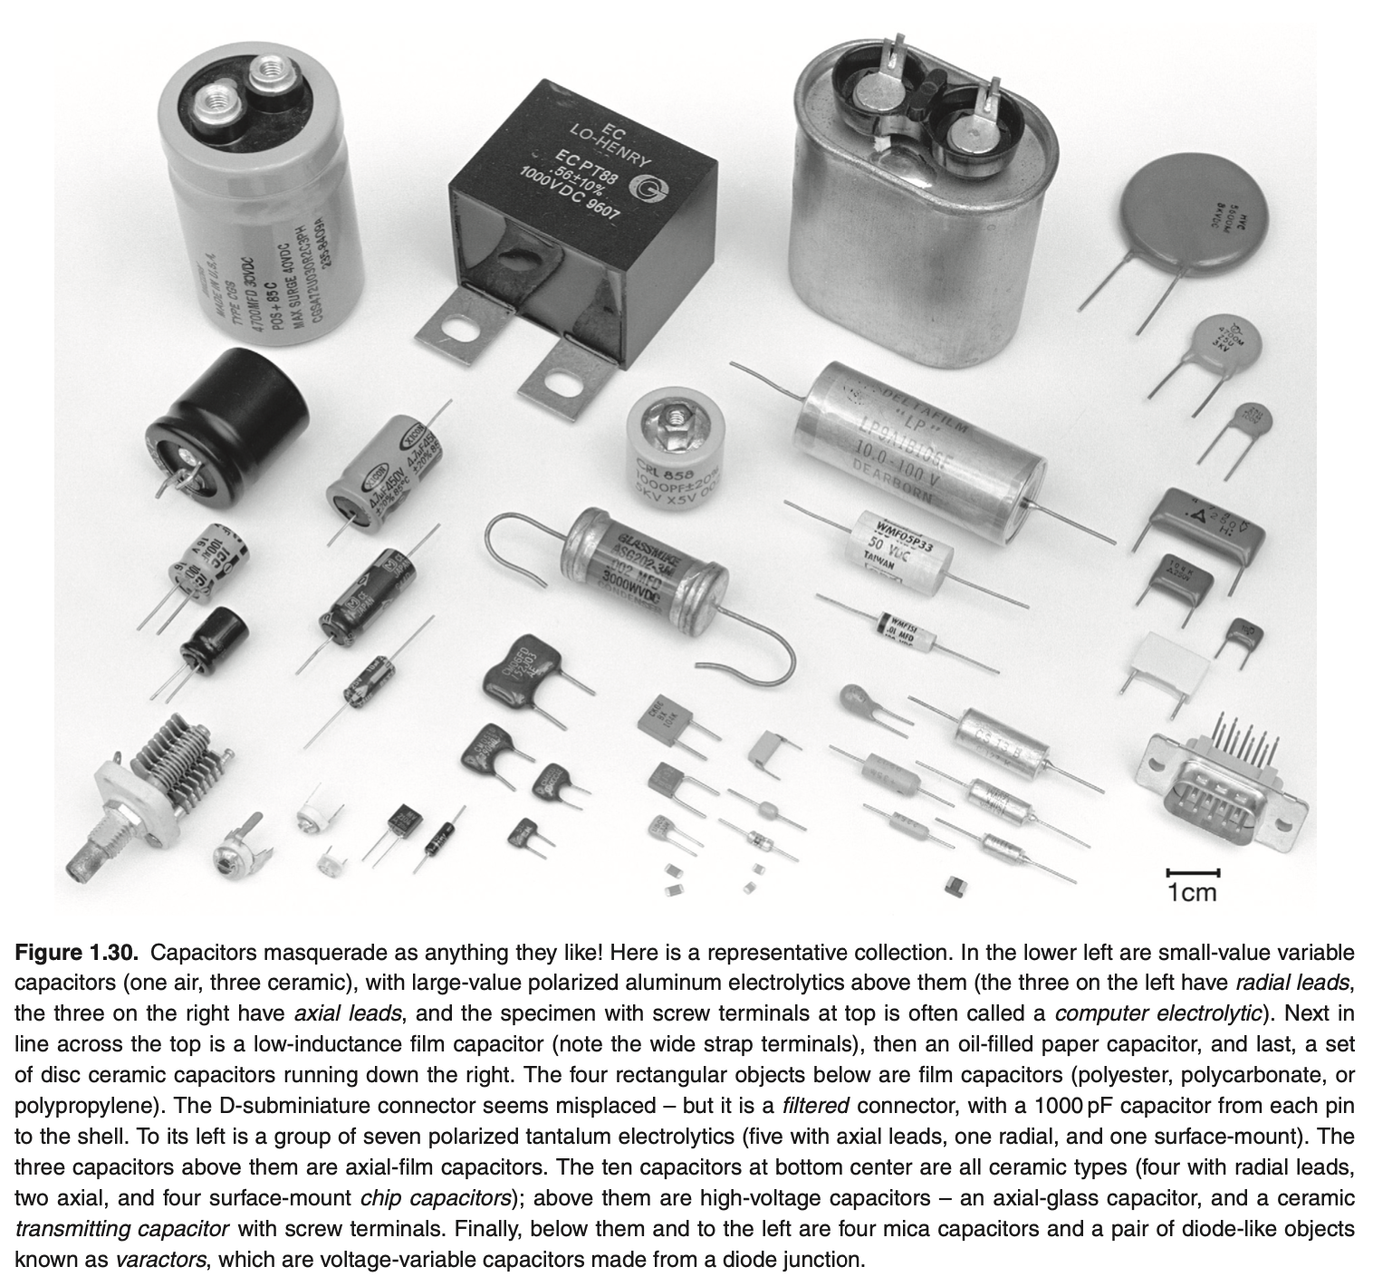
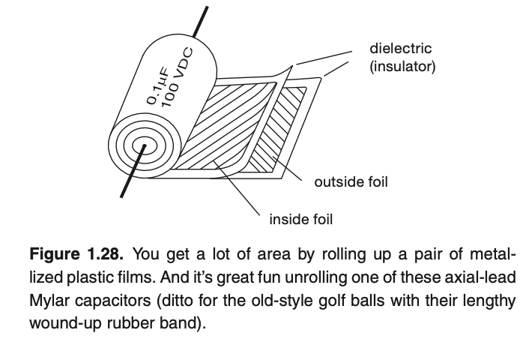
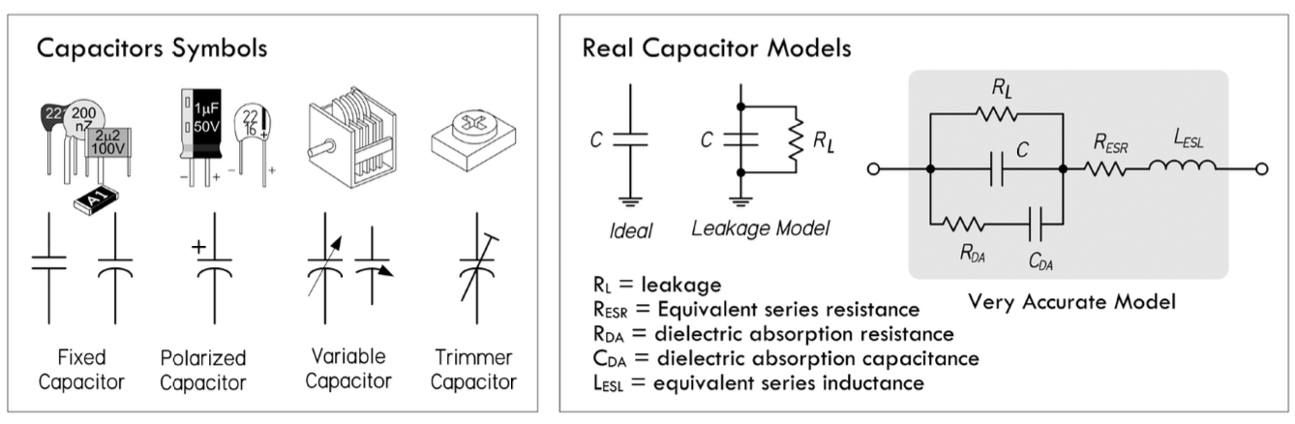
Capacitors

Slide 16
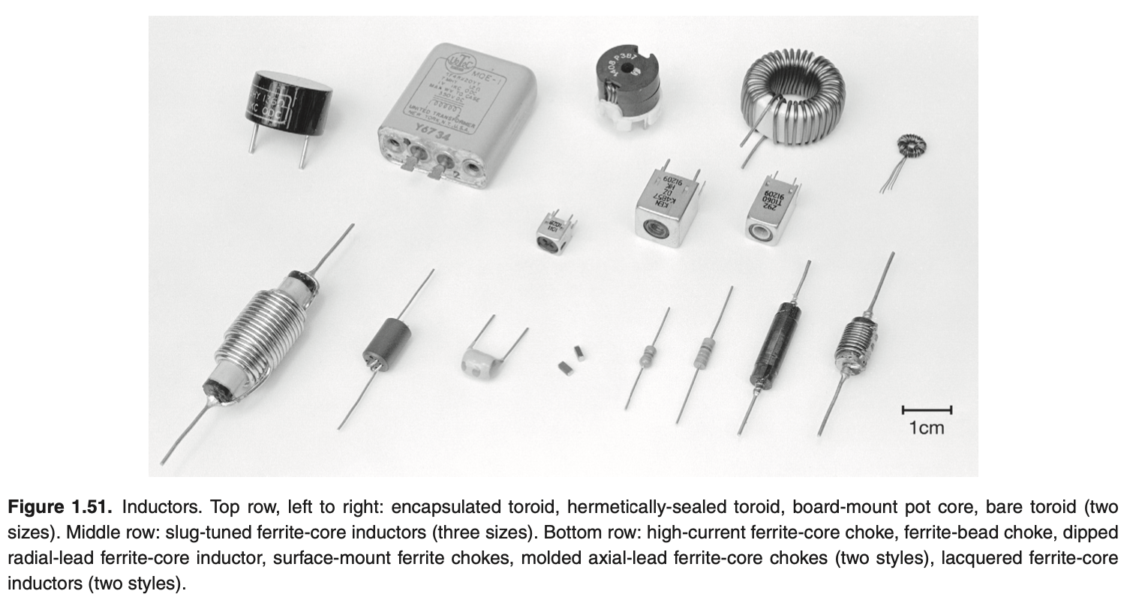
Inductors

Slide 17
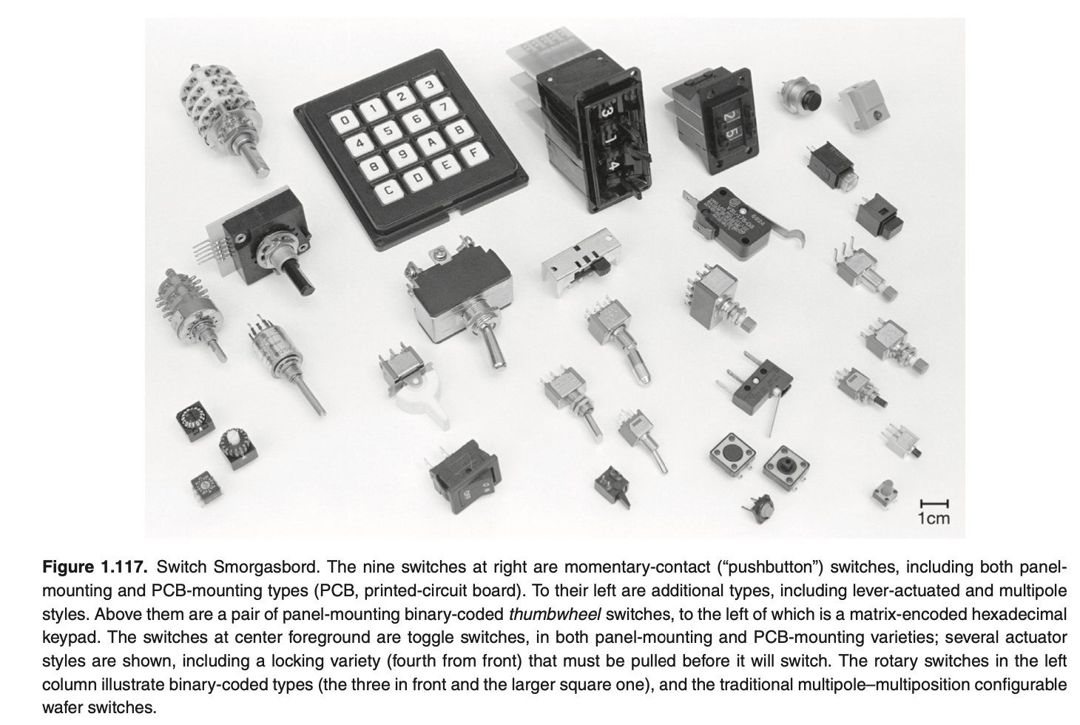
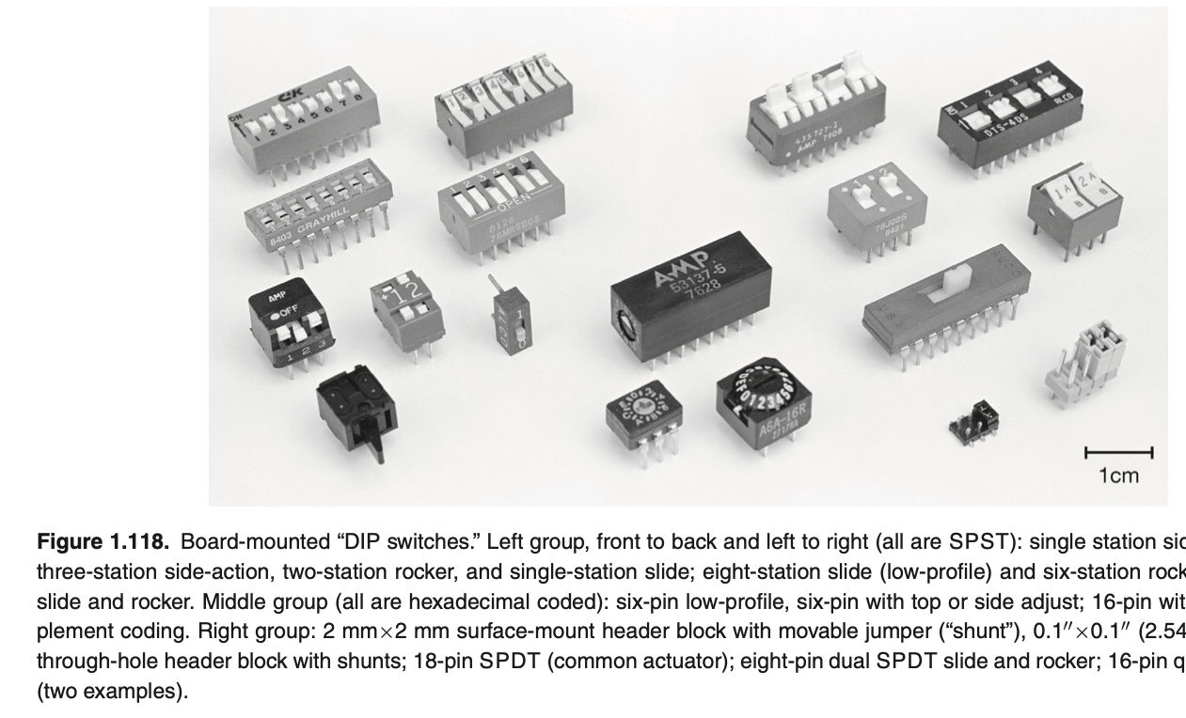
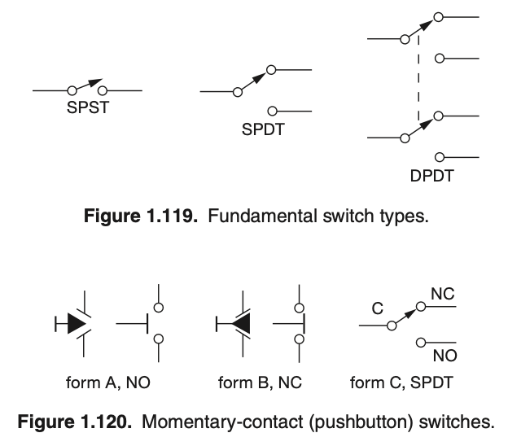
Switches

Slide 18


SMD components

Slide 19

Course Plan

Slide 20
Lab Plan
Power Supplies [5]
Toy/Smart Campus Device [15]
Medical Device [15]
RTOS Bot [15]
Each project will have:
- 5 marks for final submission
Rest of the marks = Sum of each lab’s evaluation normalized to 10
To be submitted:
Sch, brd files
List of components
Presentation
Code
Menti

Slide 21
Tools
Eagle/KiCAD
Everycircuit
3D printing

Slide 22

References
Books
Art of Electronics, 3rd Ed. By Paul Horowitz, Winfield Hill
Practical electronics for Inventors by Paul Scherz
https://anupamsobti.notion.site/Embedded-Systems-bf7a3f7e510a444aacaa875ac0c7d83c?pvs=4

Slide 23
The building blocks
Peripherals
Power delivery network
Peripheral Interfaces
Processor
RAM
Reliable power source
Persistent Memory
Communication
Compute

Slide 24

Power Supplies
AC to DC
VDC to VDC
Simple regulator circuit -> Rectifier + Filter
https://everycircuit.com/circuit/5073547604787200
Step-Down
Step-Up
Problems?
Powerline ripple
VDC to IDC
Constant Current sources

Slide 25

Types of power Supplies
Basic idea:
Use a voltage reference with some negative feedback to provide regulation

Slide 26

Example regulator
https://everycircuit.com/circuit/5202706431737856
Stability
Overcurrent Protection
Overvoltage Crowbar
Ref: AOE

Slide 27


Thank AIC designers for
7805, 7812, etc.
With a current of upto 1.5A
Ref: PEI

Slide 28
The assignment
Lesson 1: Read the datasheets uA7800 Series (Rev. J) (sparkfun.com)
7805 has internal short circuit protection
Lesson 2: Never trust a software setting. Trust what you see. [mil widths]
Lesson 3: Never trust a circuit blindly that you find on the internet

Slide 29

Adjustable regulators
Reverse Protection Diode
Ref: PEI

Slide 30

Specifications
Output voltage (5V)
Accuracy (10%)
Min and max input voltage (7-12V)
Ripple rejection
Temperature stability
Output impedance
Also note,
Linear regulators have dropouts (~2V drop between input to output -> Use LDO for lower dropouts, e.g., LM2940)
Expected Load = 100mA – 2 A
Ref: PEI

Slide 31


Metrics
Ripple
Dropout voltage
Power Supply Rejection Ratio

Slide 32


Heat Sink
Degrees per watt
Ref: AOE

Slide 33


Ground plane as heat sink

Slide 34
Solution Discussion

Slide 35


Common Applications

Slide 36



Lower Drop Out
5V -> 3.3V -> 2.5V [Multiple power rails]
Operating from a (declining) battery?
Fractional output-current sample

Slide 37

The common problem?
Energy dissipation in the pass transistors
Continuously running currents
Low efficiency
High heat generation

Slide 38

Switchers
The cons:
- Noise
Pros:
- Compact size
- Small capacitor & transistor sizes
- Lower power consumptions
- Saturation or cutoff operation
- No dropouts
- Reliability

Slide 39


Charge Pumps
Voltage Inverter
Voltage Doubler
Sec 9.6.3 (AOE 3rd ed)

Slide 40

Switchers with inductors
[Feedback eliminated for simplicity]
Oscillation Cycles
Charge the inductor (increase current)
Let the inductor charge the capacitor

Slide 41

Buck Converter
https://everycircuit.com/circuit/6494788991582208

Slide 42



Boost Converter
https://everycircuit.com/circuit/5152487425966080

Slide 43


Battery Chargers
Constant Current (CC) Constant Voltage (CV) Charging
: CC-CV charging
Typical set point voltage = 4.2 +/- 50mV
1C charging rate = charging current equal to A-hr rating of the cell
Isn’t the battery charged at the end of current limit phase? What’s happening in the CV phase?
The current is reducing and hence the entire 4.2V is from the charge stored and not the drop across ESR (Equivalent Series Resistance)
Ref: TI Note

Slide 44



LP2951
Other options LP2952 (higher current)
LM317 (cheaper)

Slide 45

Bonus: Magic Circuit (Joule Thief)
https://everycircuit.com/circuit/5969382857244672

Slide 46
More common ICs
Ch 17, Practical Electronics for Inventors
- Audio
- Power
- RF
- Medical

Slide 47
Tool Installation
PlatformIO for AVR controllers

Slide 48


Make PCBs not War
Peripherals
Power delivery network
Peripheral Interfaces
Processor
RAM
Reliable power source
Persistent Memory
Communication
Compute
Basic tutorial: tech.guitarsite.de/pcb_layout

Slide 49


What’s a PDN?

Slide 50


Why is this difficult?
Because a wire is not always a wire. It’s a transmission line..
Impedance discontinuities lead to signal reflections -> Degraded signal quality
https://everycircuit.com/circuit/5698102557933568
Introduction to Signal Integrity for PCB Design - YouTube

Slide 51
Why does it matter?
Setup and Hold Time Requirements
Signal to noise ratio
When does it not matter?
Low frequency signals (rise length l_{R} = t_{R}V < 10*trace length)
Or very short connections [a small PCB is (almost) always a better PCB]

Slide 52



In action
Avoid cross-overs
Power Delivery Network Analysis (Rev. A) (ti.com)

Slide 53


Crosstalk
Coupling
Capacitive: Two conductors induce charge in each other
Inductive: inducing current in a nearby conductor
Radiative: Track acting as an antenna
Common impedance (e.g., ground plane): Return paths interfering with other return paths
Avoiding crosstalk
Increase distance between wires
Use differential signaling
Route traces at right angles (wrt other traces)
Use termination
Keep analog/digital return paths separate

Slide 54



How can you handle it?
Continuous impedance
Stick to 45 degree routes
- continuous impedance
- less chance of inductive coupling
- better for etching/flex
Proper terminations into components
Symmetric grounding
Ground planes
Introduction to Signal Integrity for PCB Design - YouTube

Slide 55




How can you handle it?
Use decoupling capacitors
Top 5 Beginner PCB Design Mistakes (and how to fix them) - YouTube
Use different track widths for signal/power
Space Things Out

Slide 56

Let’s see some PCBs!

Slide 57
Arduino Uno Rev3
Observe:
Voltage Regulation
Ferrite beads
Fuses
Decoupling Capacitors
Perpendicular lines in the two planes
Ground Plane
Different mill widths in analog and digital paths
ICSP – In Circuit Serial Programming Interface
USB to Serial conversion with Atmega16U2

Slide 58
The building blocks
Peripherals
Power delivery network
Peripheral Interfaces
Processor
RAM
Reliable power source
Persistent Memory
Communication
Compute

Slide 59
Microcontrollers
Embedded into a device that’s certainly not a “computer”
No disk to boot from
On-chip compute, memory – both RAM and NVM (Flash) + ADC/DAC + onboard debug and programming interfaces
Opamp – the universal analog component | μC – the universal digital component
Ref: AOE Ch 15

Slide 60


Anatomy of a μC

Slide 61


ATtiny85
[Datasheet]
8 kB Flash
256 bytes SRAM
512 bytes of EEPROM
Watchdog Timer (wake me up)
Internal oscillator/two timer interrupts – do work periodically
All I/O pins interfaces with ADC
I2C, Serial interfaces

Slide 62


Where’s my clock?
Note: Datasheet is God!
Contains details of all registers to be programmed for a certain function as well

Slide 63


Attiny LED Blinker
How to Blink an LED with ATtiny85 | ATtiny85 Programming - YouTube
ATTiny Port Manipulation (Part 1): PinMode() and DigitalWrite() : 7 Steps - Instructables

Slide 64
More complex μCs
AVR (mostly single core)
AC Power Control
Thermal Controller
Remote Controller
STM32 (multi-core)
Drones
Smartwatches/Airpods/Apple TV
PLCs
Medical Monitors/FItbits
Car infotainment systems
Synthesizers and MIDI Controllers
Macbook pro touchbar
Digital Stethoscopes
DSP
Audio signal processing, e.g., FFTs
Audio enhancement/noise reduction, etc.
Notice:
No mention of OS yet

Slide 65



Common interfaces Switch
Ref: PEI
Also, pullup/pulldown

Slide 66



Debounce
Hardware Debounce
Software Debounce

Slide 67




Controlling LEDs

Slide 68


Analog Input
Direct
Ref: PEI

Slide 69


High power digital outputs
Typical AVR pin = 40 mA current
Remember to use diodes with inductive components, e.g., relays

Slide 70




Motors

Slide 71

Detecting sound levels
Looking for more interfaces?
Refer AOE 15.8

Slide 72




Capturing Sound
Microphones
From an audio jack

Slide 73



Generating Sound
Load = 8 ohm piezo speaker

Slide 74





Amplifying Sound
Linear on-board amplifiers (low gain)
Common ICs – LM386, LM383

Slide 75

Talking to other devices
Ref:AOE

Slide 76



One-wire
Pull Up
Reset = 480 μS
0 = 15 μS
1 = 60 μS
Power-less operation

Slide 77






I2C (TWI)
Sending Data
5/3.3V – 500 bits/s
No parasitic mode – 4 wire interface
Receiving Data

Slide 78

I2C (TWI)

Slide 79

Some common I2C devices
I2C Sensors
I2C ADC (Analog-to-Digital Converters)
I2C DAC (Digital-to-Analog Converters)
I2C GPIO Expanders
I2C Real-Time Clock (RTC) Modules
I2C EEPROM (Electrically Erasable Programmable Read-Only Memory)
I2C OLED Displays
I2C Motor Controllers
I2C Audio Codecs
I2C GPIO Sensors
I2C Expansion Hubs
I2C RTC with NVRAM (Non-Volatile RAM)
I2C Touch Sensors
I2C LED Drivers
I2C Motor Encoders
I2C Gas Sensors
RTC

Slide 80



SPI
Note: Full duplex (upto 80 Mbit/s)

Slide 81


TTL Serial
Rx, Tx with fixed baud rates
110, 300, 600, 1200, 2400, 4800, 9600, 14400, 19200, 38400, 57600, 115200, 128000, and 256000.
Full Duplex

Slide 82
MODBUS
An industry standard interface on top of RS485 like signals
Also implemented over ethernet with TCP/IP stack
Common in gas/water/energy meters, etc.

Slide 83

USB
Introduced in 1905
V1 - Low Speed, Full Speed (1. 5 Mbps/12 Mbps) [Differential voltage]
V2 – High speeds (480 Mbps) [Differential voltage based binary encoding]
V3 – Superspeed (4.8 Gbps via shielded twisted pairs) [8b/10b encoding]
V3.1 – 9.6 Gbps with increased DC power options – 5V, 2A or 12/20V 5A with USB C connector
Master-slave Star Topology

Slide 84

Controller Area Network (CAN)
Multidrop km-range bus accommodating upto 30 transceiver nodes
1Mbps for 40m and 10 kbps at 1km (max)
Quiet bus on no data
Collisions and backoffs

Slide 85

Programming a Microcontroller

Slide 86

Programming μC != Programming a computer
There’s only one CPU!
No task switching unless you make it switch
Plenty of parallel hardware to use
Use interrupts as much as possible – to (not) wait for all kinds of things!
Sei() – global interrupt enable
Cli() – global interrupt disable
Note: The next few slides are Atmega328P specific

Slide 87

Instruction execution

Slide 88


Memories
1 kB EEPROM
- parallel r/w
- SPI r/w

Slide 89
Clock

Slide 90

Power Management

Slide 91

I/O
DDRx
PORTx
PINx

Slide 92

Timer

Slide 93



ADC Types
Successive Approximation
Example DAC
Delta-Sigma ADC
Delta-Sigma Modulator Basics - YouTube
https://everycircuit.com/circuit/5048641919909888
How delta-sigma ADCs work, Part 1 (Rev. A) (ti.com)
Sigma-Delta ADC Compared to SAR ADC - Developer Help (microchipdeveloper.com)

Slide 94

ATMega 328P ADC

